Slide 1


TripForge — MERN Travel Planner
One-line idea: Collaborative itinerary builder with integrated expense tracking for smarter trips.
Team: 3 developers — frontend, backend, and devops. Audience: Hackathon judges & technical peers.
KISHOR R
PRADEEP A
SANDEEP T
SRIDHAR CH
Notes:
1

Slide 2
The Challenge
Real-world problem
Why it matters
Key challenges
Travel planning is fragmented — itineraries, budgets, and receipts live across apps and spreadsheets, causing friction and overspend.
Groups need coordinated schedules and transparent expenses to avoid miscommunication and financial surprises during trips.
  Synchronizing multi-user itineraries in real time
  Capturing expenses with receipts and categorization
  Secure role-based access (owner vs guest)
Notes:
2

Slide 3

Our Innovation
Core Differentiators
Key Features
  Unified itinerary + expense model (single source of truth)
  Live collaboration with optimistic UI updates
  Role-based permissions + lightweight dispute resolution flow
  Create/manage destinations, dates, activities, budgets, and expenses
  Attach receipt images, auto-categorize via tags (OCR-ready)
  Shareable trip links, offline-first React views, and exportable reports
Design focuses on minimal friction: fast CRUD flows and clear ownership of costs.
Notes:
3

Slide 4
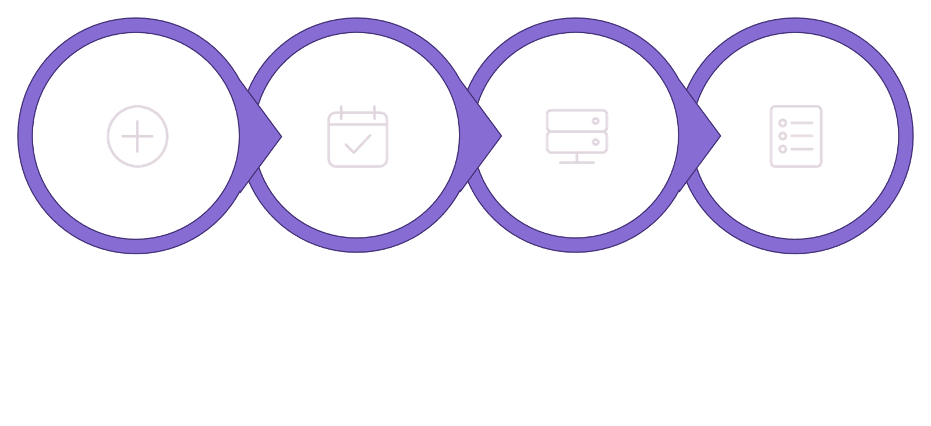
How It Works
Add Activities
Backend Validate
Show Itinerary
Create Trip
User journey (condensed): User creates trip → teammates add activities & receipts → server validates and persists documents → UI shows synchronized itinerary, per-person balances, and exportable summaries.
Notes:
4

Slide 5
Technology & Algorithm
Tech stack
Core algorithms & choices
  Frontend: React (hooks, context, React Router)
  Backend: Node.js + Express.js REST APIs
  Database: MongoDB with Mongoose schemas (trips, users, expenses)
  Auth: JWT + role-based middleware (owner, editor, viewer)
  Deployment: Docker + CI pipeline
  Expense split algorithm: proportional and equal-split modes with per-item overrides
  Optimistic UI + background reconciliation for low-latency collaboration
  Indexing strategy: compound indexes on tripId + date for fast itinerary queries
  Why chosen: MERN enables rapid end-to-end development and JSON-native data flow.
Notes:
5

Slide 6

Demo & Impact
What we show in demo
Practical benefits
  Create trip, add destinations and per-day activities
  Add expenses with receipt metadata; view per-person balances
  Role-based actions: owner approves refunds, guests propose edits
  Reduce planning time: single app for schedule + budget
  Cut disputes: clear, auditable expense records
  Scales from small groups to large itineraries via paginated queries and indexed schema
Live demo highlights: sub-second UI updates and consistent expense reconciliation.
Notes:
6

Slide 7


Future Vision & Next Steps
1
2
3
Short-term roadmap
Scale & reliability
Long-term features
Finish OCR receipt parsing, add push notifications, and implement currency conversion microservice.
Move to managed MongoDB clusters, add horizontal scaling for API layer, and integrate monitoring + alerting.
Personalized recommendations (activities, budgets) and marketplace integrations (bookings, insurance).
Final takeaway: TripForge demonstrates a focused MERN implementation solving a clear real-world need — rapid prototyping now, production-grade scaling next.
Notes:
7

Slide 8
Thank you
Notes:
8

